Slide 1

Neural Networks

Slide 2
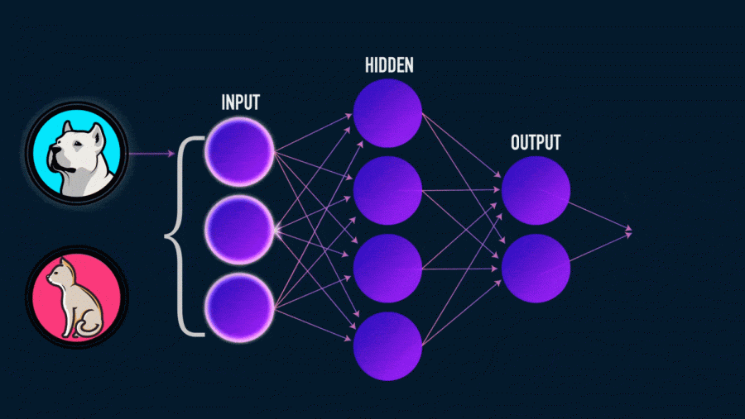
Neural network - an attempt using mathematical models to reproduce the work of the human brain to create machines with artificial intelligence. An artificial neural network is usually trained with a teacher. This means that there is a training set (dataset) that contains examples with true values: tags, classes, indicators.

Slide 3
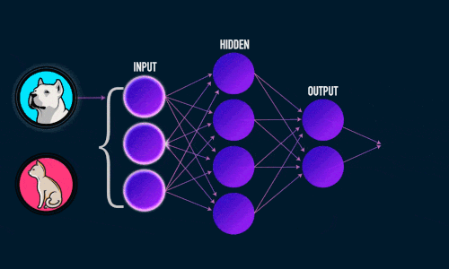
Examples
For example, if you want to create a neural network to assess the tonality of the text, the dataset will be a list of sentences with corresponding emotional ratings. The tone of the text is determined by signs (words, phrases, sentence structure) that give a negative or positive coloring. The weights of the signs in the final assessment of the tonality of the text (positive, negative, neutral) depend on the mathematical function, which is calculated during the training of the neural network. Previously,
people generated tags
manually. The more signs
and the more accurately
weights are selected, the more
accurate the answer.
A neural network has
automated this process.

Slide 4
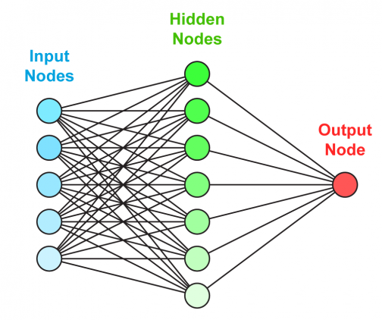
An artificial neural network consists of three components: Input layer; Hidden (computational) layers; Output layer.

Slide 5
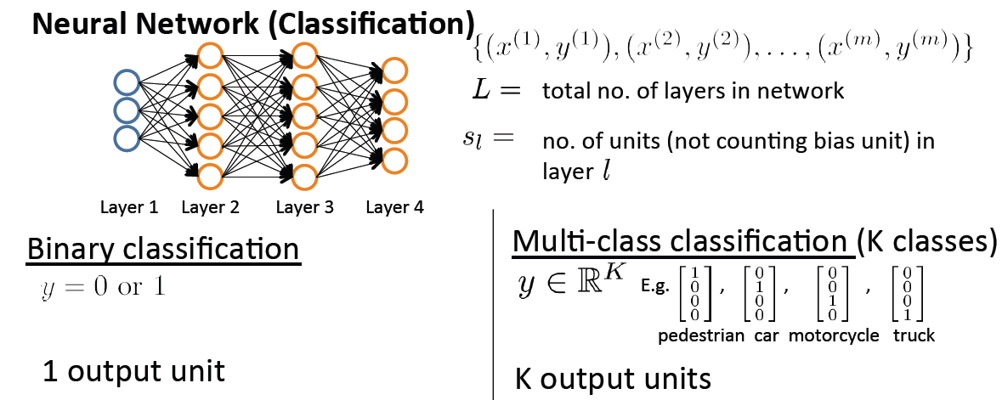
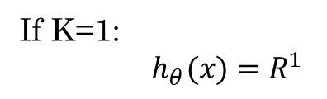
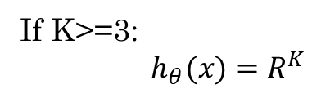
If K=1:
${ h}_{θ}(x)=R^{1}$
If K>=3:
${ h}_{θ}(x)=R^{K}$
$${Number of units on each level: s}_{1}=3,s_{2}=5,s_{3}=5,s_{L}{=s}_{4}=4$$

Slide 6
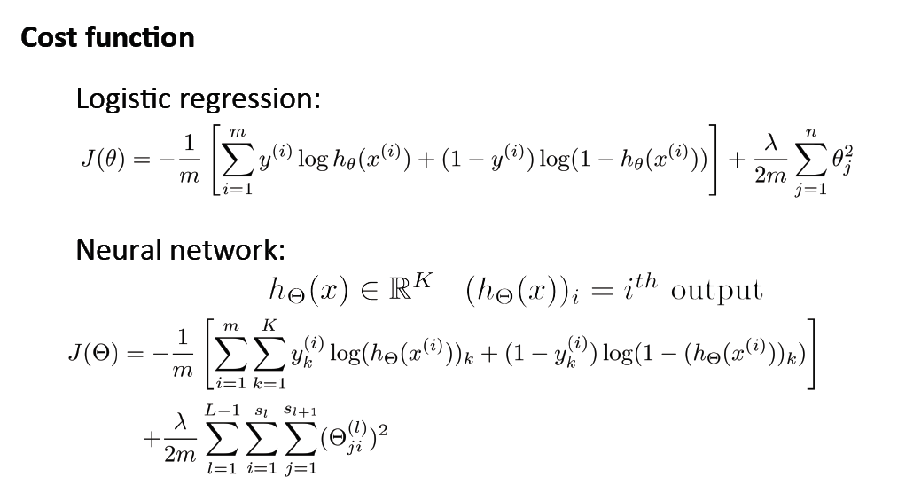

Slide 7
Details
Neural networks are trained in two stages: Direct error propagation; Reverse error propagation. During forward error propagation, a prediction of the response is made. With back propagation, the error between the actual response and the predicted is minimized.

Slide 8
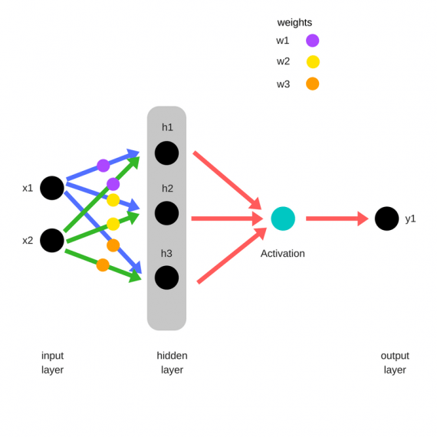
forward error propagation
Randomly chosen!
j
Multiply the input by the weights to form a hidden layer:
h1 = (x1 * w1) + (x2 * w1)
h2 = (x1 * w2) + (x2 * w2)
h3 = (x1 * w3) + (x2 * w3)
The output from the hidden layer is transmitted through a non-linear function (activation function), to obtain the network output:
y_ = fn(h1 , h2, h3)

Slide 9
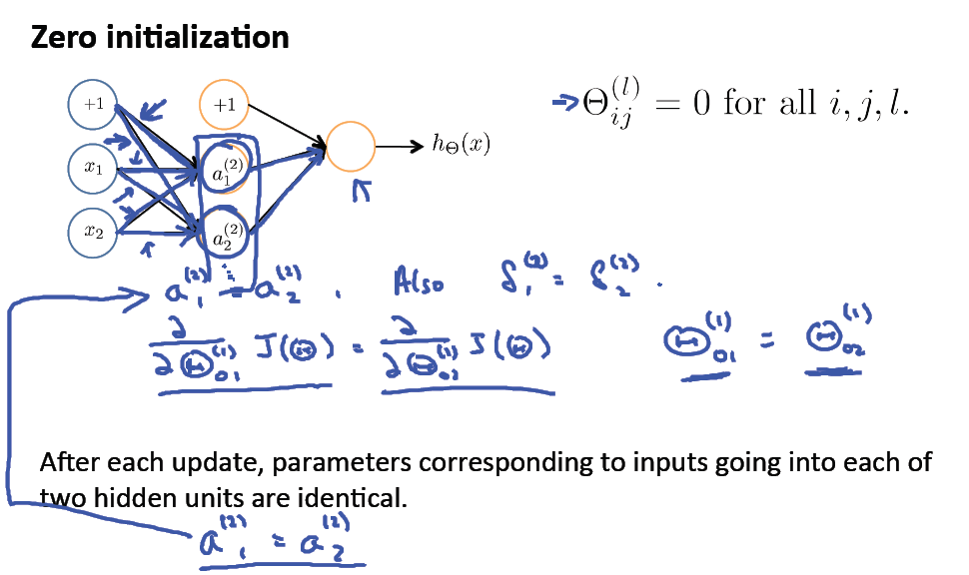

Slide 10
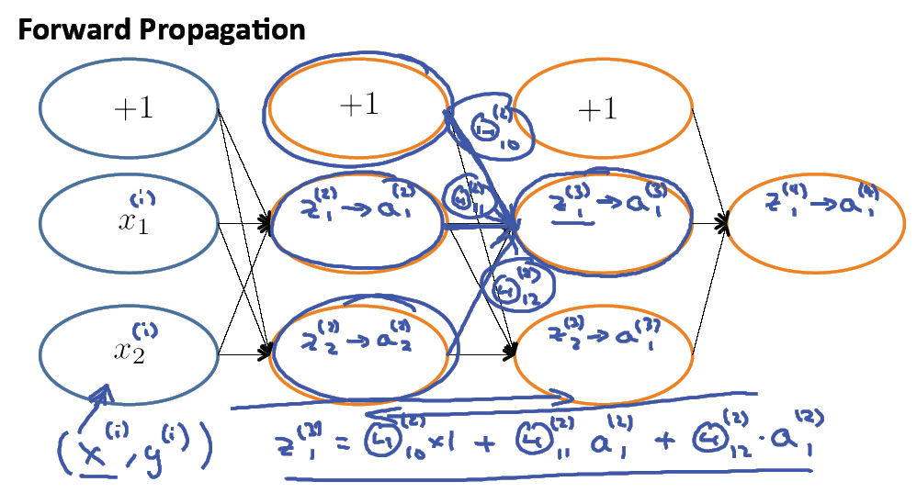
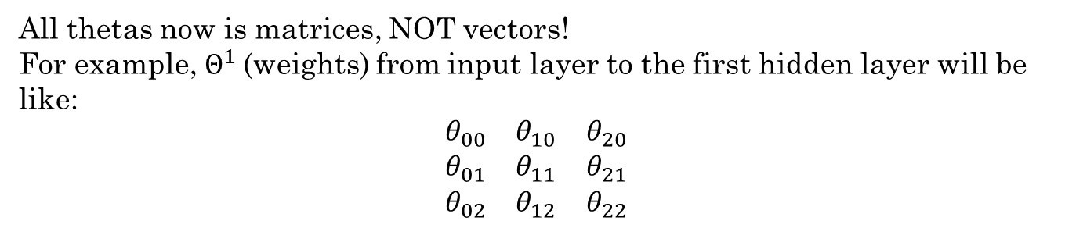
All thetas now is matrices, NOT vectors!
For example, $Θ^{1}$(weights) from input layer to the first hidden layer will be
like:
$$\begin{matrix}θ_{00} & θ_{10} & θ_{20} \\ θ_{01} & θ_{11} & θ_{21} \\ θ_{02} & θ_{12} & θ_{22}\end{matrix}$$

Slide 11
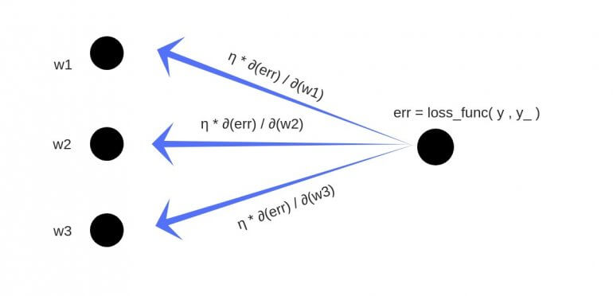
back propagation
As a result, we will get the following updates of weights:
w1 = w1 — (alpha * ∂(cost) / ∂(w1))
w2 = w2 — (alpha * ∂(cost) / ∂(w2))
w3 = w3 — (alpha * ∂(cost) / ∂(w3))

Slide 12
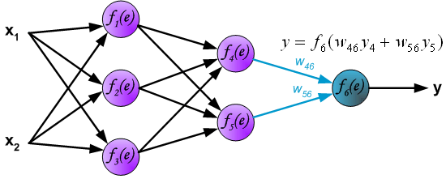
Learning Algorithm: Backpropagation
Propagation of signals through the output layer.

Slide 13
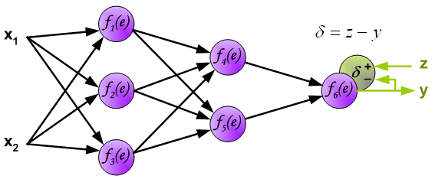
Learning Algorithm: Backpropagation
In the next algorithm step the output signal of the network y is compared with the desired output value (the target), which is found in training data set. The difference is called error signal d of output layer neuron

Slide 14
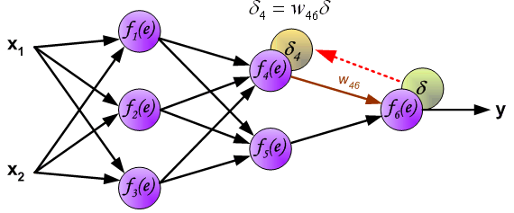
Learning Algorithm: Backpropagation
The idea is to propagate error signal d (computed in single teaching step) back to all neurons, which output signals were input for discussed neuron.

Slide 15
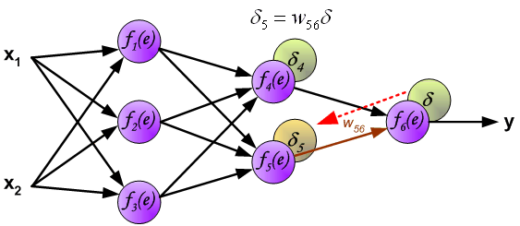
Learning Algorithm: Backpropagation
The idea is to propagate error signal d (computed in single teaching step) back to all neurons, which output signals were input for discussed neuron.

Slide 16
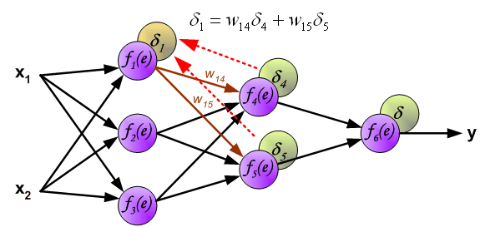
Learning Algorithm: Backpropagation
The weights' coefficients w_{mn} used to propagate errors back are equal to this used during computing output value. Only the direction of data flow is changed (signals are propagated from output to inputs one after the other). This technique is used for all network layers. If propagated errors came from few neurons they are added. The illustration is below:

Slide 17
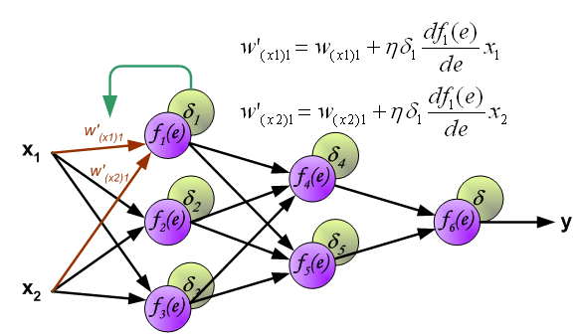
Learning Algorithm: Backpropagation
When the error signal for each neuron is computed, the weights coefficients of each neuron input node may be modified. In formulas below df(e)/de represents derivative of neuron activation function (which weights are modified).

Slide 18
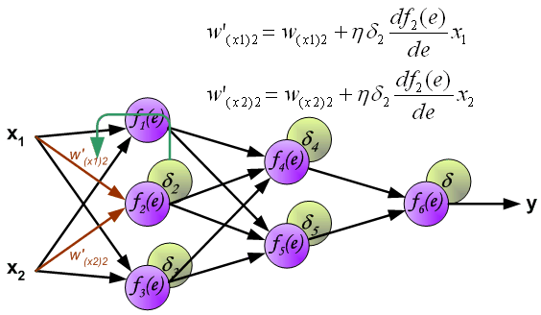
Learning Algorithm: Backpropagation
When the error signal for each neuron is computed, the weights coefficients of each neuron input node may be modified. In formulas below df(e)/de represents derivative of neuron activation function (which weights are modified).

Slide 19
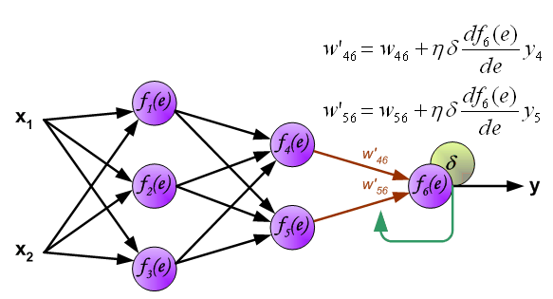
Learning Algorithm: Backpropagation
When the error signal for each neuron is computed, the weights coefficients of each neuron input node may be modified. In formulas below df(e)/de represents derivative of neuron activation function (which weights are modified).

Slide 20
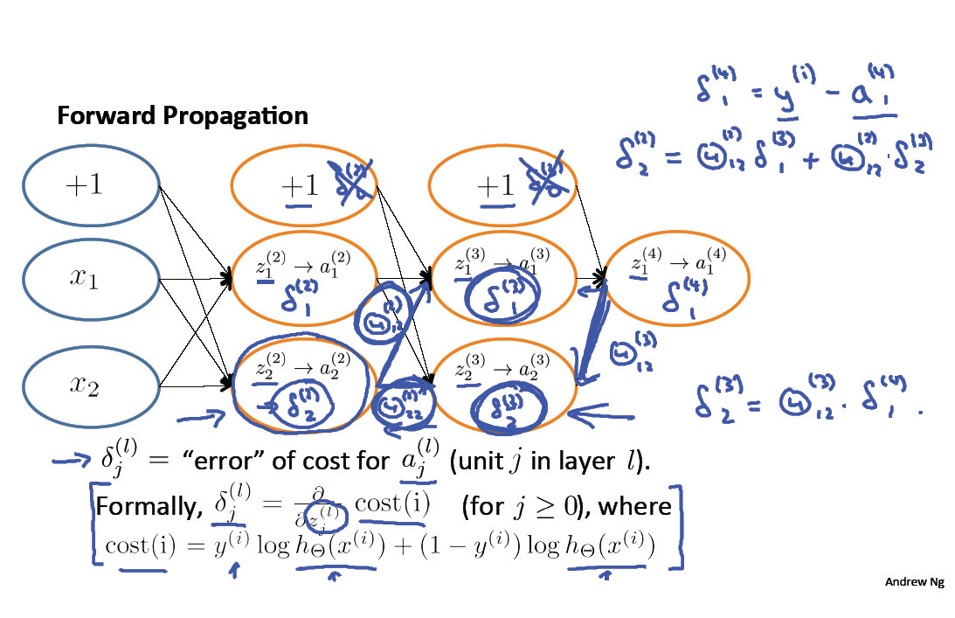

Slide 21
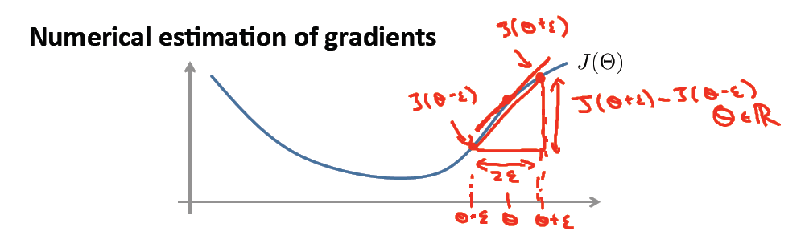
Why it works?
Private derivatives The partial derivatives can be calculated, therefore, it is known what contribution to the error was for each weight. The need for derivatives is obvious. Imagine a neural network trying to find the optimal speed for an unmanned vehicle. If the car detects that it is traveling faster or slower than the required speed, the neural network will change speed, speeding up or slowing down the car. What does it accelerate / decelerate? Derivative speeds.

Slide 22
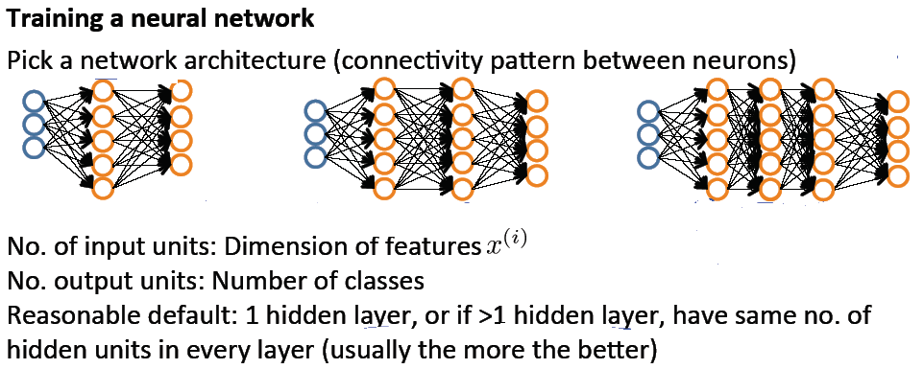

Slide 23
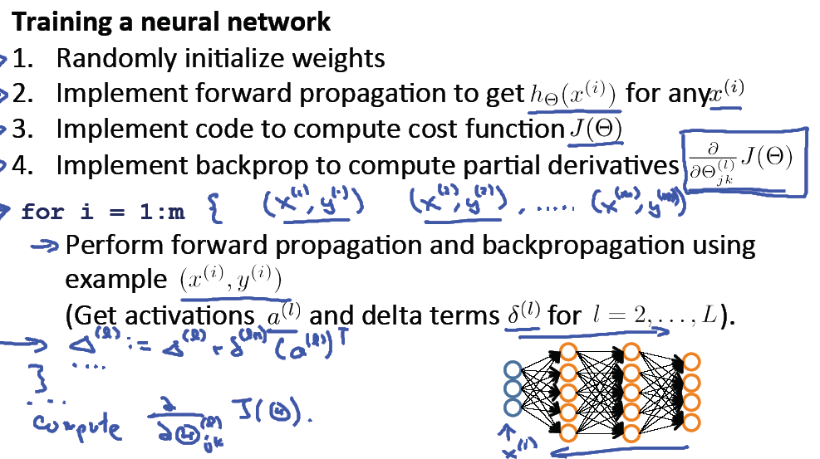

Slide 24
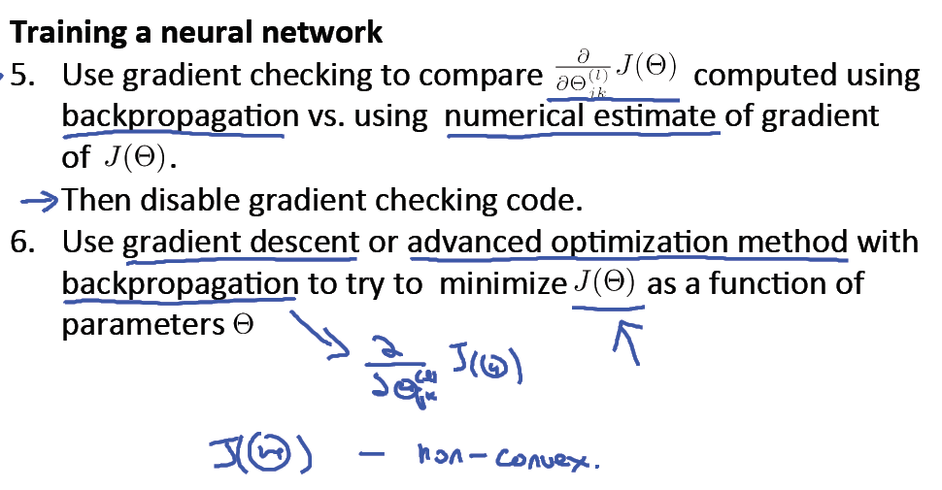

Slide 25
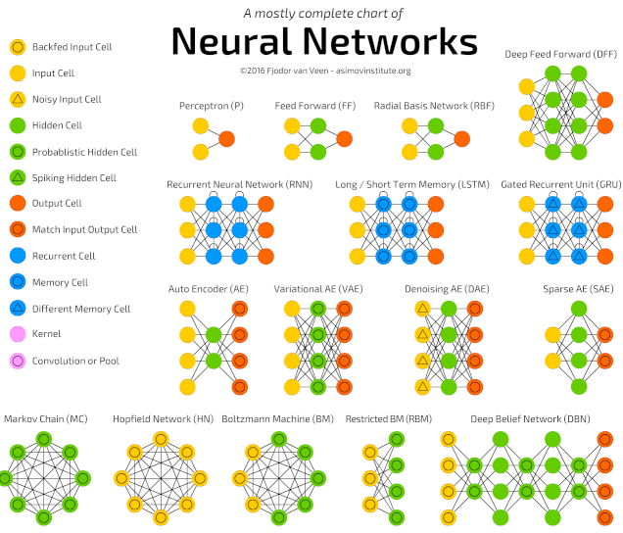
The most popular deep neural networks

